Slide 1
Linear Hashing
Hardeep Singh
3089450

Slide 2
Contents
Introduction
Historical background
Basic Idea for Linear Hashing
Insertion Algorithm
Insertion Example
Searching Algorithm
Searching Example
Implementation
Output
Applications of linear hashing
References

Slide 3
Introduction to Hashing
Defination:-
Hashing is the process of mapping a key value to a position in a table.
Types of Hashing
1. Static Hashing
2. Dynamic Hashing
a) Extendible Hashing
b) Linear Hashing
A hash function maps key values to positions.
A hash table is an array that holds the records.

Slide 4
Introduction to linear hashing
Linear hashing is a dynamic hash table algorithm invented by Witold Litwin (1980), and later popularized by Paul Larson.
Linear Hashing is a dynamically updateable disk-based index structure which implements a hashing scheme and which grows or shrinks one bucket at a time.
Compared with the B+-tree index which also supports exact match queries (in logarithmic number of I/Os), Linear Hashing has better expected query cost O(1) I/O.
Compared with Extendible Hashing , Linear Hashing does not use a bucket directory, and when an overflow occurs it is not always the overflown bucket that is split.
The name Linear Hashing is used because the number of buckets grows or shrinks in a linear fashion.
Overflows are handled by creating a chain of pages under the overflown bucket.
The hashing function changes dynamically and at any given instant there can be at most two hashing functions used by the scheme.

Slide 5
Historical Background
A hash table is an in-memory data structure (Array) that associates keys with values.
The primary operation it supports efficiently is a lookup: given a key, and the corresponding value. It works by transforming the key using a hash function into a hash, a number that is used as an index in an array to locate the desired location where the values should be.
Multiple keys may be hashed to the same bucket, and all keys in a bucket should be searched upon a query.
Hash tables are often used to implement associative arrays, sets and caches. Like arrays, hash tables have O(1) lookup cost on average.

Slide 6
Basic Idea
Pages are split when overflows occur – but not necessarily the page with the overflow.
Splitting occurs in turn, in a round robin fashion. one by one from the first bucket to the last bucket.
Use a family of hash functions h₀, h₁, h₂, ...
Each function’s range is twice that of its predecessor.
When all the pages at one level (the current hash function) have been split, a new level is applied.
Splitting occurs gradually.
Primary pages are allocated in order & consecutively.

Slide 7
Insertion Algorithm
initially the hash file comprises M primary buckets numbered 0, 1, … M-1
the hashing process is divided into several phases (phase 0, phase 1, phase 2, …). In phase j, records are hashed according to hash functions h_{j}(key) and h_{j+1}(key)
h_{j}(key) = key mod (2^{j}*M)
phase 0: h₀(key) = key mod (2⁰*M), h₁(key) = key mod (2¹*M)
phase 1: h₁(key) = key mod (2¹*M), h₂(key) = key mod (2²*M)
phase 2: h₂(key) = key mod (2²*M), h₃(key) = key mod (2³*M)

Slide 8
Spllitting buckets
If a bucket overflows its primary page is chained to an overflow page (same as in static hashing).
Also when a bucket overflows, some bucket is split.
The first bucket to be split is the first bucket in the file (not necessarily the bucket that overflows).
The next bucket to be split is the second bucket in the file … and so on until the Nth. has been split.
When buckets are split their entries (including those in overflow pages) are distributed using h₁.
To access split buckets the next level hash function (h₁) is applied.
h₁ maps entries to 2N₀ (or N₁)buckets.
splitting occurs according to a specific rule such as
an overflow occurring, or
the load factor reaching a certain value, etc.
a split pointer (n) keeps track of which bucket to split next
split pointer goes from 0 to 2^{j}*M - 1 during the j^{th} phase, j= 0, 1, 2, … ...

Slide 9
Load Factor
Formula for load factor
load factor = n/m
Where,
n is total number of enteries in hash table.
m is total number of buckets in hash table.
It can be set according to need.

Slide 10
Example
initially suppose M=4
h₀(key) = key mod M; i.e. key mod 4 (rightmost 2 bits)
h₁(key) = key mod 2*M Capacity of bucket is 2
As the file grows bucket split and records are redistributed using h1 (key)= Key Mode 2*M.
n=0
0 1 2 3 4 n=1 ,after the split

Slide 11
Example contd…
collision resolution strategy: chaining
split rule: if load factor > 0.70
insert the records with key values:
3, 2, 4, 1, 8, 14, 5, 10, 7, 12
The bucket to be added during expansion
0 1 2 3 4 5 6 7

Slide 12
Example contd…
when inserting the sixth record (using h₀ = Key mod M) we would have
n=0 before the split
0 1 2 3
4
8
1
2
14
3

Slide 13
Example contd…
when inserting the sixth record (using h₀ = Key mod M) we would have
n=0 ,before the split
0 1 2 3
but the load factor 6/8= 0.75 > 0.70 and so bucket 0 must be split (using h₁ = Key mod 2M):
n=1,after the split
load factor= 6/10 = 0.6
0 1 2 3 4 no split
4
8
1
2
14
3
8
1
2
14
3
4

Slide 14
Example contd…
Inserting (5)
0 1 2 3 4
insert(5)
n=1, Load
factor= 7/10= 0.7 . 0 1 2 3 4 no split
8
1
2
14
3
4
8
1
5
2
14
3
4

Slide 15
Example contd…
.
0 1 2 3 4
insert(10)
n=1,load . factor: 8/10 =0.8
split using h1
overflow
8
1
5
2
14
3
4
8
1
5
2
14
3
4
10

Slide 16
Example contd…
.
n=2,load factor:
8/12=0.66
overflow No split
8
1
2
14
3
4
5
10

Slide 17
Example contd…
Insert(7) insert(7)
0 1 2 3 4 5
n=2, loadfactor= 9/12
. =0.75,split using h1
overflow
8
1
2
14
3
4
5
8
1
2
14
3
7
4
5
10

Slide 18
Example contd…
.
0 1 2 3 4 5 6 n=3,load factor=9/14=0.64
no split
8
1
2
10
3
7
4
5
14

Slide 19
Example contd…
.
Insert(12) n=3,load factor=10/14
=0.71,split using h1
0 1 2 3 4 5 6 7
8
12
1
2
10
3
7
4
5
14
8
12
1
2
10
3
4
5
14
7

Slide 20
Example contd…
.
0 1 2 3 4 5 6 7 . n=4 ,load factor= 10/16 = 0.625
no split
At this point, all the 4 (M) buckets are split. n should be set to 0.
It begins a second phase.
In the second phase, we will use h₁ to insert records and h₂ to split a bucket.
h₁(K) = K mod 2M and h₂(K) = K mod 4M.
8
12
1
2
10
3
4
5
14
7

Slide 21
Searching Algorithm
A search scheme is needed to map a key k to a bucket, either when searching for an existing record or when inserting a new record. The search scheme works as follows:
If hi(k) >= n, choose bucket hi(k) since the bucket has not been split yet in the current round.
If hi(k) < p, choose bucket hi+1(k), which can be either hi(k) or its split image .
Where p is the key.

Slide 22
Searching example
8
1
5
2
14
3
4
0 1 2 3 4
n=1, Pointer position
ho(5)=1 >=1 , Directly go to bucket for record
8
1
5
2
14
3
4

Slide 23
Implementation
Hardware specification:
Intel core i5
4 GB RAM
750 GB Hard Disk
Software specification:
Visual studio 2013
Microsoft window 10

Slide 24
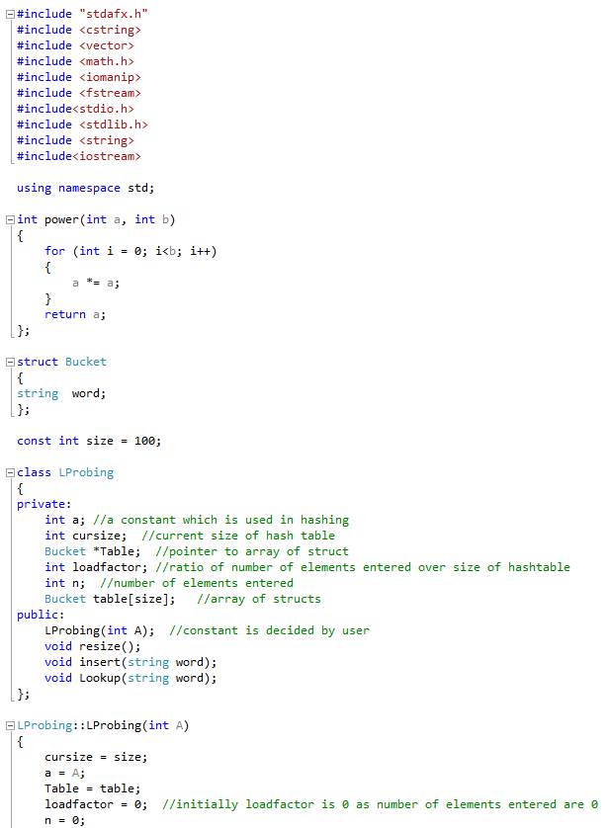
Code

Slide 25
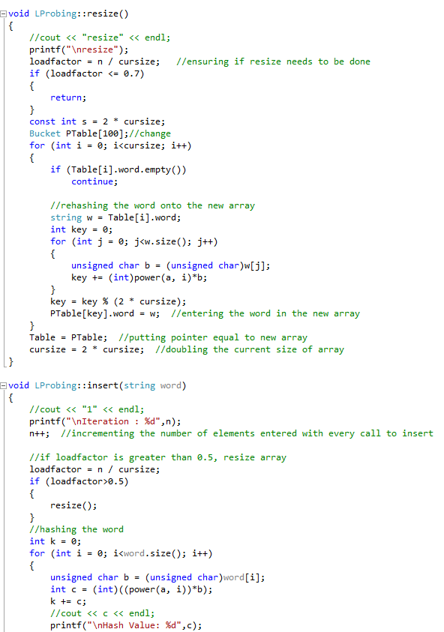
Code

Slide 26
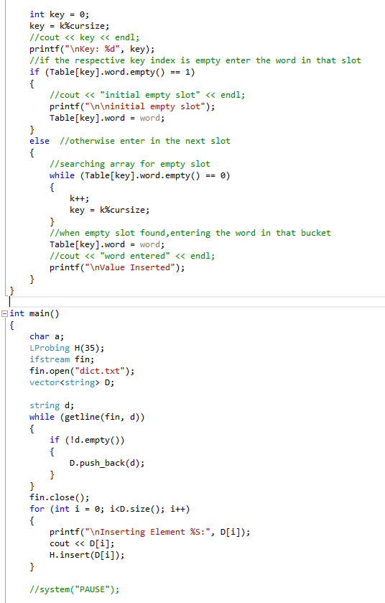
Code contd..

Slide 27
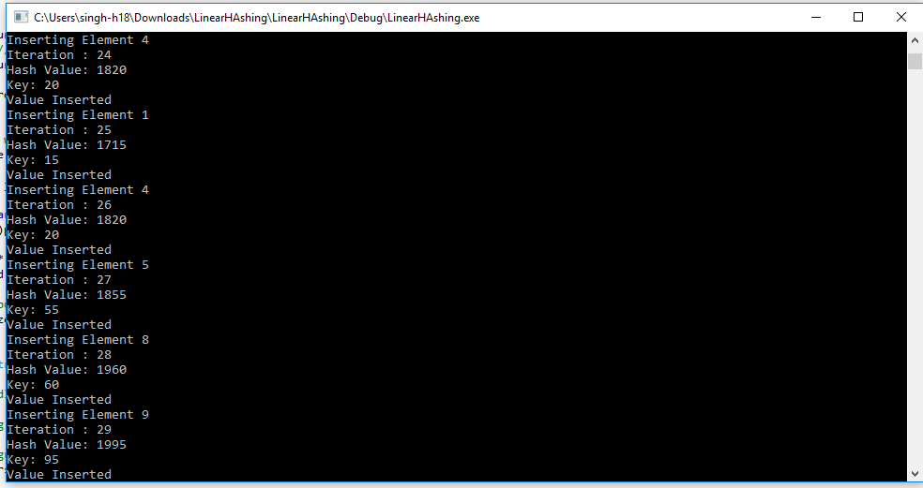
Output

Slide 28
Applications of Hashing
Linear Hashing has been implemented into commercial database systems. It is used in applications where exact match query is the most important.query such as hash join.
Compilers use hash tables to keep track of declared variables.
A hash table can be used for on-line spelling checkers — if misspelling detection (rather than correction) is important, an entire dictionary can be hashed and words checked in constant time.
Game playing programs use hash tables to store seen positions, thereby saving computation time if the position is encountered again.
Hash functions can be used to quickly check for inequality — if two elements hash to different values they must be different.
Storing sparse data.

Slide 29
References
https://en.wikipedia.org/wiki/Linear_hashing
http://arl.wustl.edu/~sailesh/download_files/Limited_Edition/hash/Dynamic%20Hash%20Tables.pdf
http://hackthology.com/pdfs/Litwin-1980-Linear_Hashing.pdf
http://cgi.di.uoa.gr/~ad/MDE515/e_ds_linearhashing.pdf

Slide 30
THANK YOU Questions?
.

